Slide 1
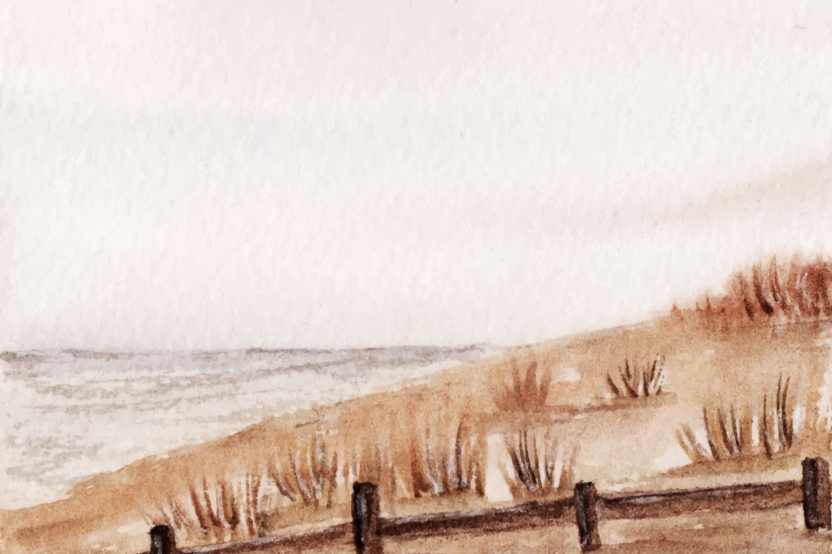
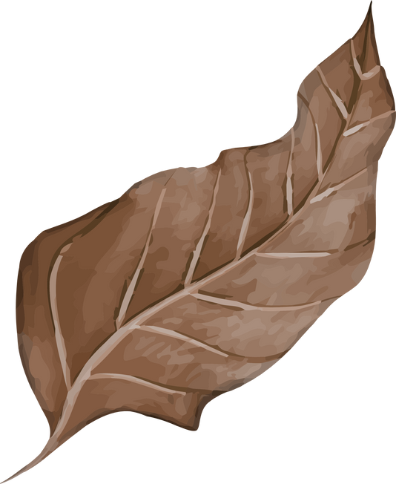
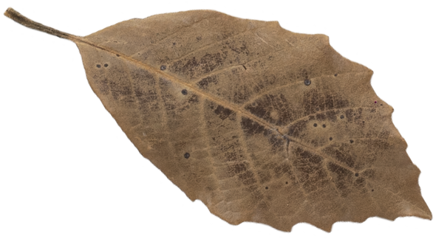
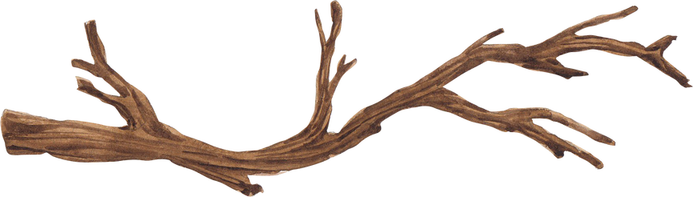
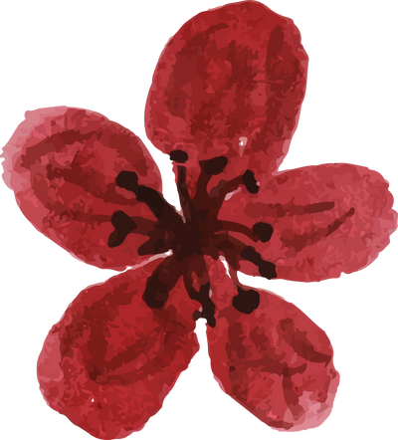

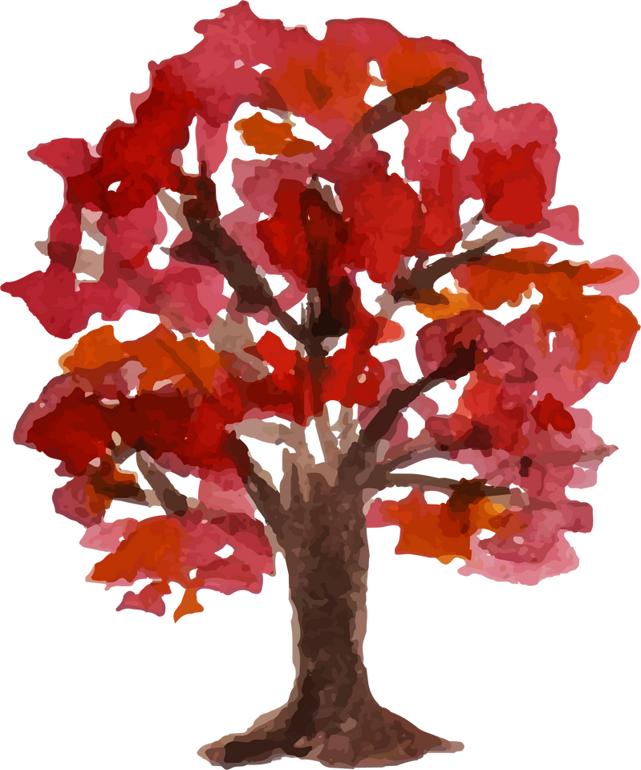
PEACE BEGINS WITH US
Inspiring Hope in the Next Generation
Sr. Nodelyn Abayan, SSS, EdD
Faith Formation Conference
St. Matthew’s Church
November 8, 2025

Slide 2
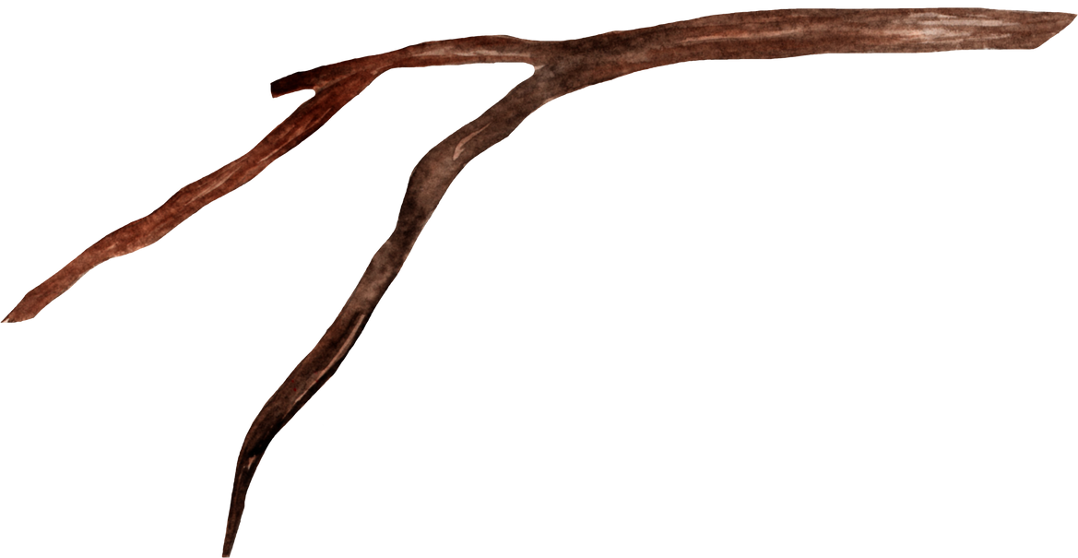


By the end of this session,
we will:
Recognize that peace begins within — rooted in faith and awareness of God’s presence.
Appreciate how children themselves reveal what it means to live peacefully in the present moment.
Reflect on how our actions, tone, and energy teach peace to children
Commit to simple ways of practicing peace daily.
Experience Christian meditation as a way to nurture inner peace

Slide 3
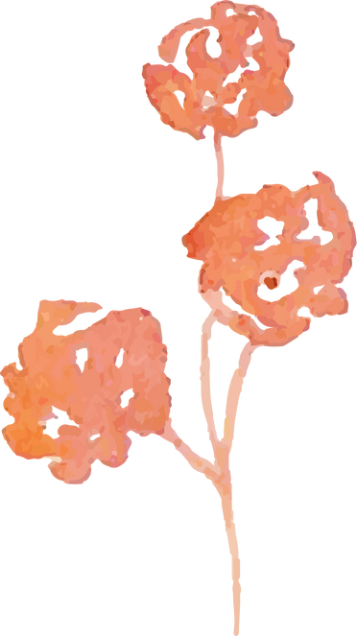
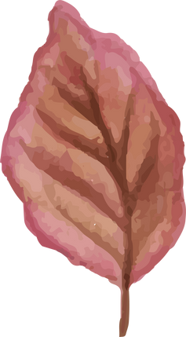
A Prayer for Peace
Lord Jesus,
You are our peace in the midst of all storms.
Quiet our restless hearts so we may listen to You within.
Help us to live each moment with love, patience, and kindness,
so that the children in our care may learn peace through us.
May we, like You, welcome and learn from them —
seeing in their joy and trust the simplicity of Your Kingdom.
Amen.

Slide 4


Peace Begins Within
“The peace of God, which surpasses all understanding, will guard your hearts
and your minds in Christ Jesus.”
— Philippians 4:7
Children absorb the spirit/energy
of the adults around them.
Our calm presence, kind words, and patient responses teach more than any lesson plan.
When we live from a peaceful heart, we make God’s presence visible to the little ones.

Slide 5

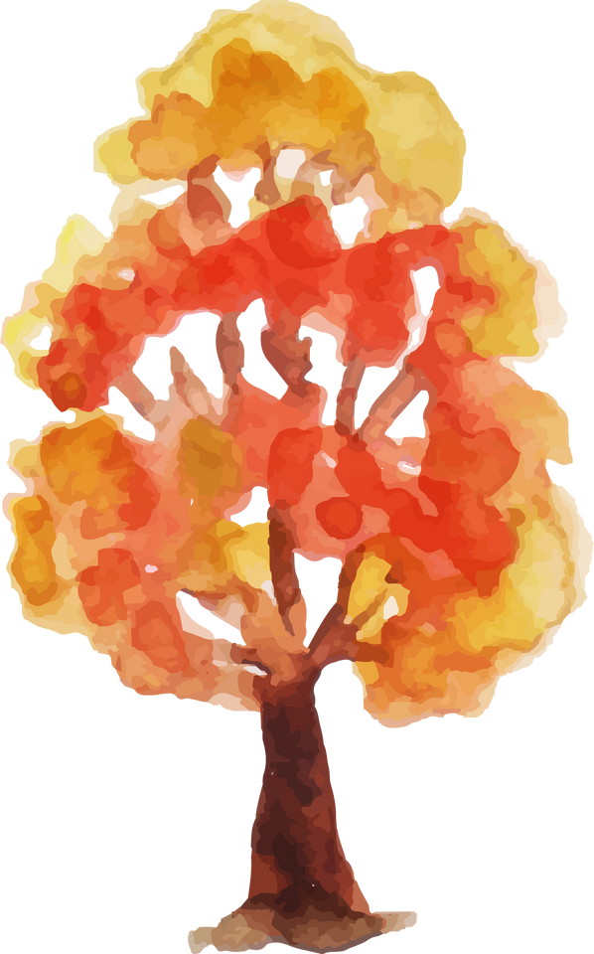

How children absorb energy
and learn from adults
*The Absorbent Mind (imitation video)
*Children are natural observers
*Emotional and energetic transmission
*Environment and actions
*Modeling Behavior
Notes:
The Absorbent Mind: According to Maria Montessori, children under six have an "absorbent mind" that allows them to soak up information and impressions from their surroundings with little effort. This includes language, movements, and human behavior
Children are natural observers. They learn by watching and modeling the behavior, attitudes, and emotional expressions of adults around them. This can be seen in how they pick up social cues like waving or how they model more complex behaviors.
Environment and actions: The environment adults create is a powerful tool for learning. For example, an adult who is constantly busy teaches the child that "busyness is how love looks," while a calm and peaceful adult models that "peace is possible"
Modeling behavior: Adults act as living blueprints for children. A child's learning is influenced by the actions they witness, not just the words they are spoken to with.

Slide 6
Reflection Prompt:
How do I bring peace into my home, classroom, or ministry setting?

Slide 7
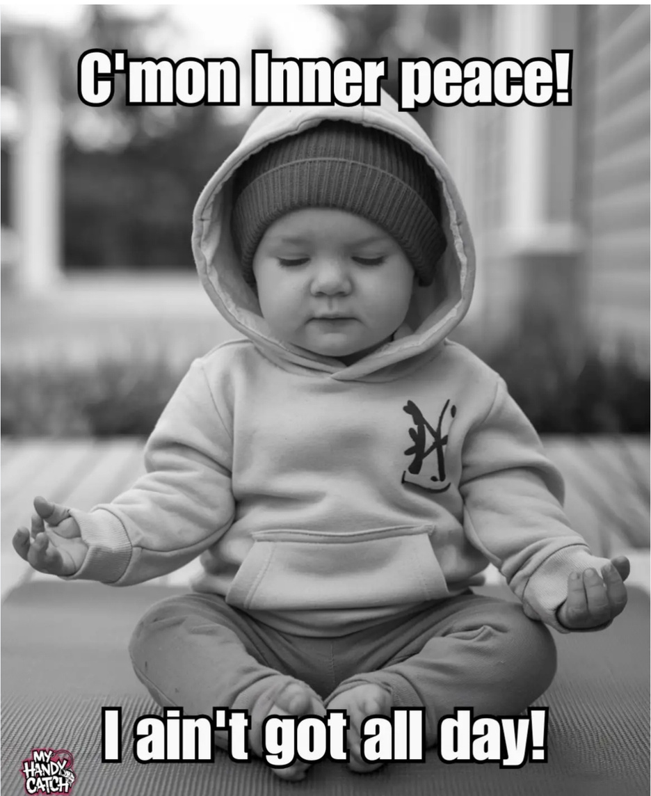

Slide 8

Living in the Present Moment :
Learning from Children
“Let the little children come to me, and do not stop them;
for it is to such as these that the kingdom of heaven belongs.”
— Matthew 19:14
They laugh freely, notice beauty, forgive easily, and trust deeply.
Children naturally live in the present moment.
In their spontaneity and openness, they remind us what it means...
to be still and know that God is near.

Slide 9

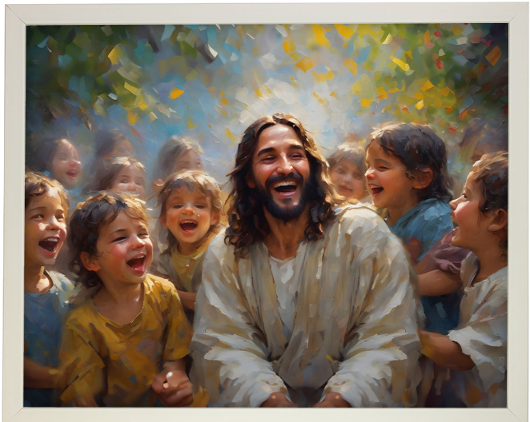
Jesus and the Children
Jesus not only blessed children — He called adults to learn from them.
Their way of being shows us how to rest in God’s love without fear or anxiety.
To teach peace, we must also become learners — receiving the sacred wisdom that children reveal every day.

Slide 10
TWO STORIES

Slide 11
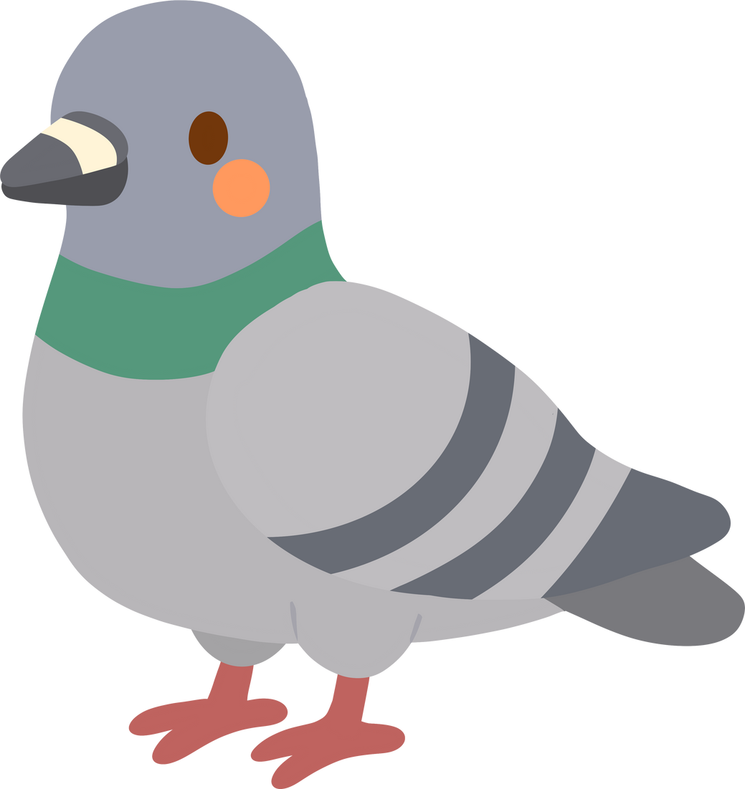
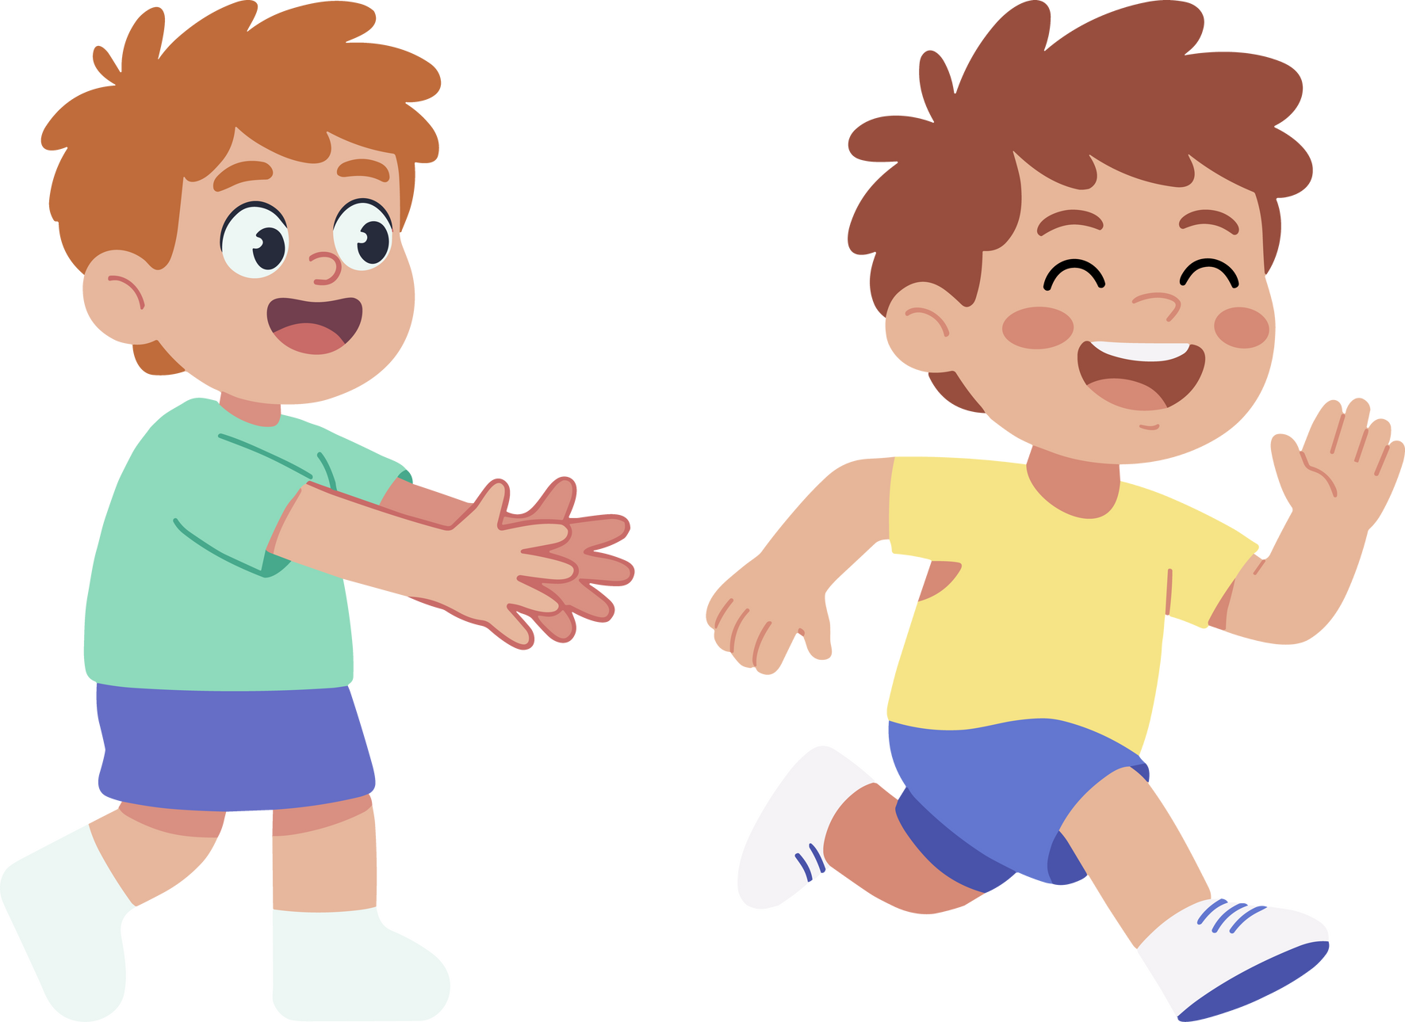
TWO STORIES
A story from a book
For children everything is vital and interesting...
Notes:
He drives an hour to take his son Emilio to the zoo, only to fin that Emilio isn't interested in the lions, monkeys, and giraffes but in chasing ordinary pigeons... and the in the midst o his frustration the author realizes that to Emilio the pigeons that to Emilio the pigeons are not common place , because nothing is a commonplace to a child. For children everything is vital and interesting. What are we being challenged here, to really look at the world through the eyes of a child.

Slide 12
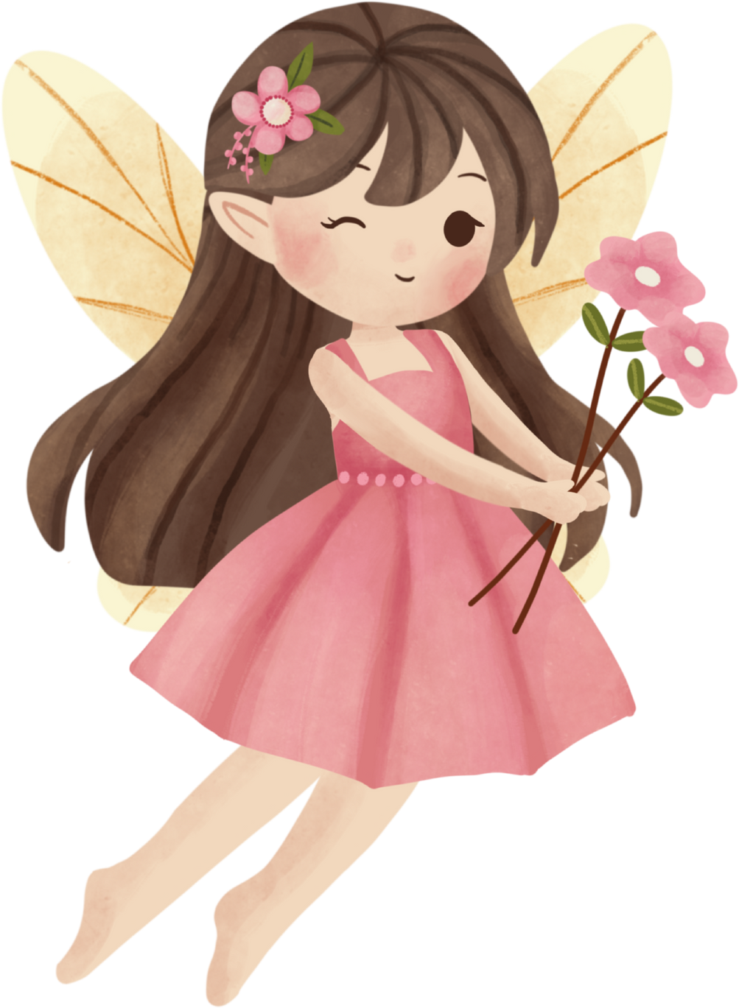
RACHEL CARSON
If I had influence with the good fairy who is supposed to preside over the christening of all children, I should ask that her gift to each child in the world be a sense of wonder so indestructible that it would last throughout life
Notes:
He drives an hour to take his son Emilio to the zoo, only to fin that Emilio isn't interested in the lions, monkeys, and giraffes but in chasing ordinary pigeons... and the in the midst o his frustration the author realizes that to Emilio the pigeons that to Emilio the pigeons are not common place , because nothing is a commonplace to a child. For children everything is vital and interesting. What are we being challenged here, to really look at the world through the eyes of a child.

Slide 13
SHARING
Can you recall an experience when a child taught you an important lesson?
What did you learn from that moment?

Slide 14


Try This:
take three slow breaths and pray:
Before beginning your day or class...
“Lord, help me to see this moment — and these children — with Your eyes.”

Slide 15
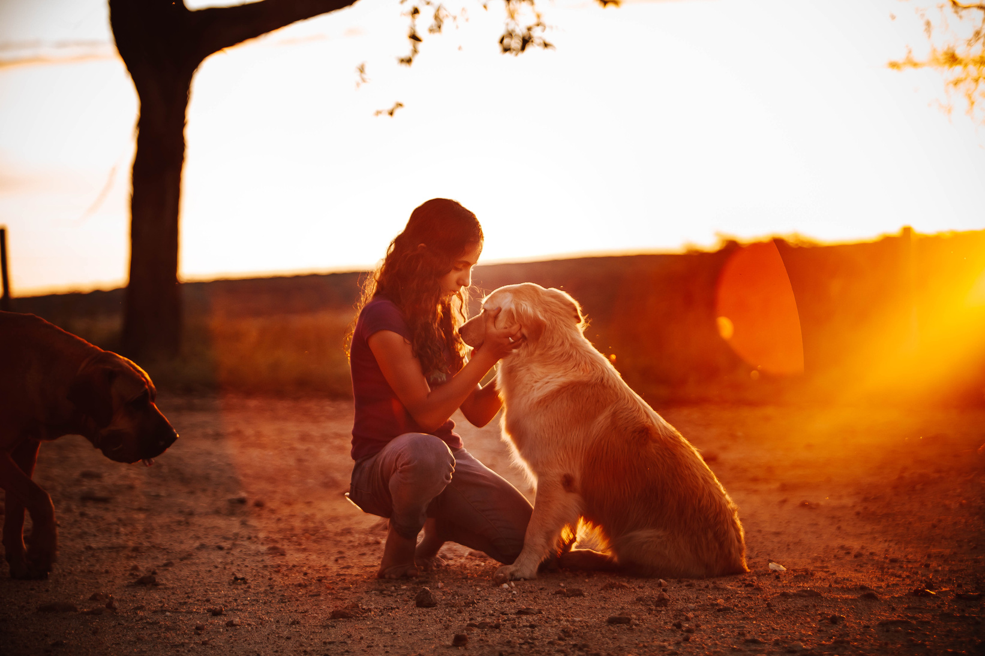
Teaching Peace through Kindness
“Be kind and compassionate to one another, forgiving each other, just as in Christ God forgave you.”
— Ephesians 4:32
Kindness is the visible face of peace
When children see us being gentle, forgiving, and respectful, they learn to do the same.
Even small acts of kindness ripple outward and form the foundation for lifelong compassion.

Slide 16
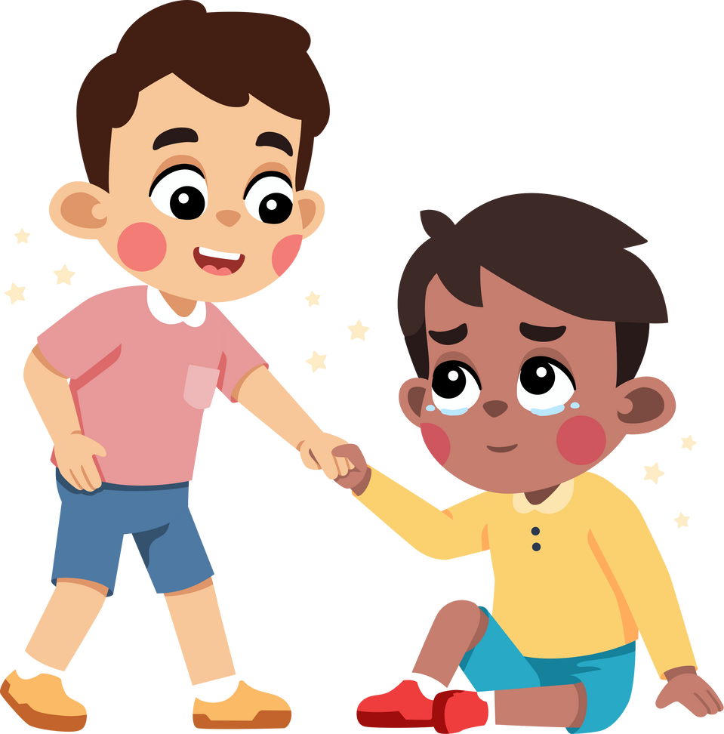
Simple Acts of Kindness for
Children to Practice:
Saying “thank you”
and
“I’m sorry”
Sharing joyfully
Helping a friend in need
Speaking gently

Slide 17
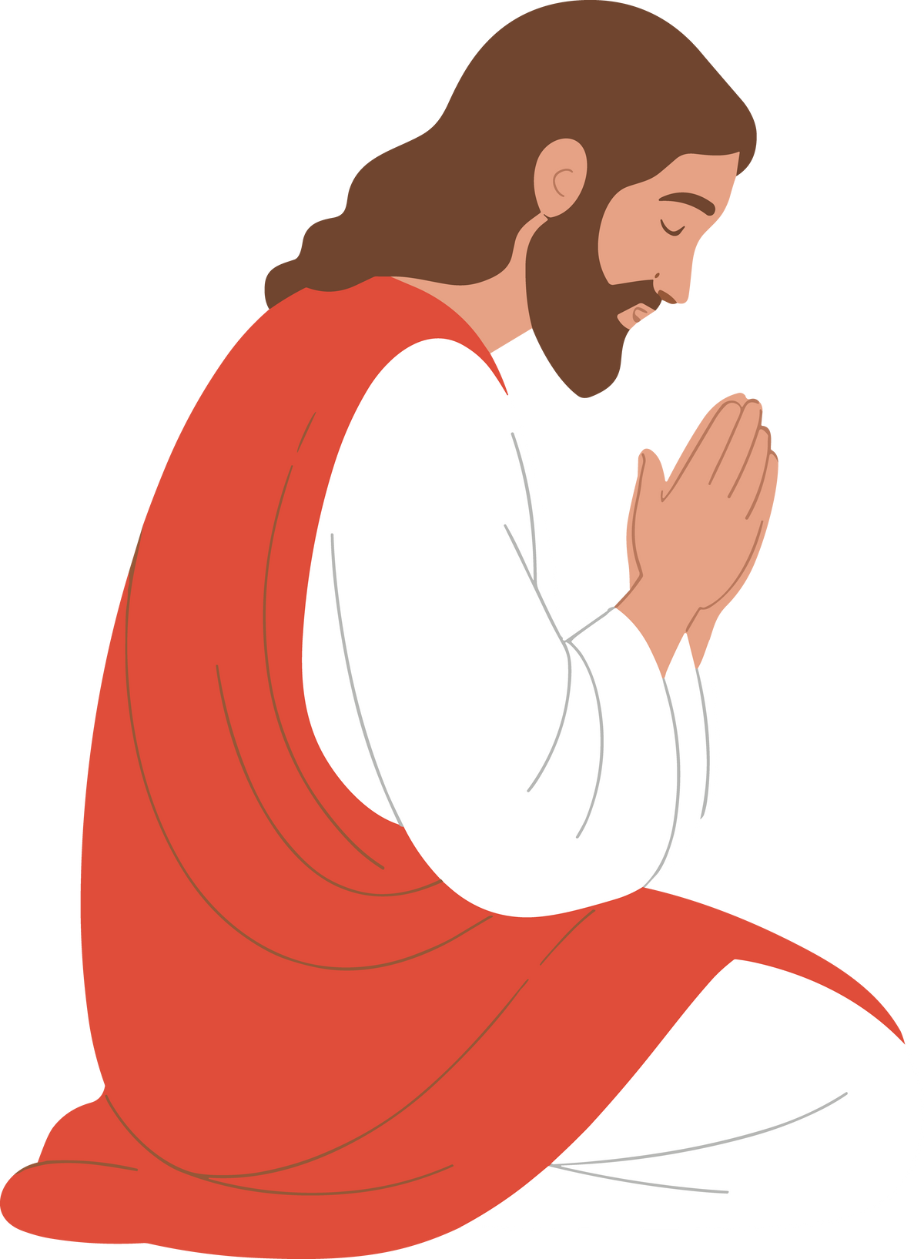
Let us PRACTICE
Christian Meditation
How to Practice:
Sit comfortably, close your eyes, and breathe calmly.
Silently repeat a sacred word — for example, “Maranatha” (Come, Lord Jesus).
When thoughts come, gently return to your prayer word.
Remain in silence for 3–5 minutes.
Notes:
Christian meditation helps us enter the stillness where God’s peace dwells.
It can be shared with children in short, quiet moments — before prayer, after playtime, or at bedtime.

Slide 18
“Be still, and know that I am God.”
— Psalm 46:10

Slide 19
Sharing and Reflection
How do I model peace for children in my care?
What can I learn from the children I teach or parent about living peacefully?
When is it hardest for me to stay peaceful?
What can I do this week to help a child experience peace?
Write down one small action you will commit to this week.

Slide 20
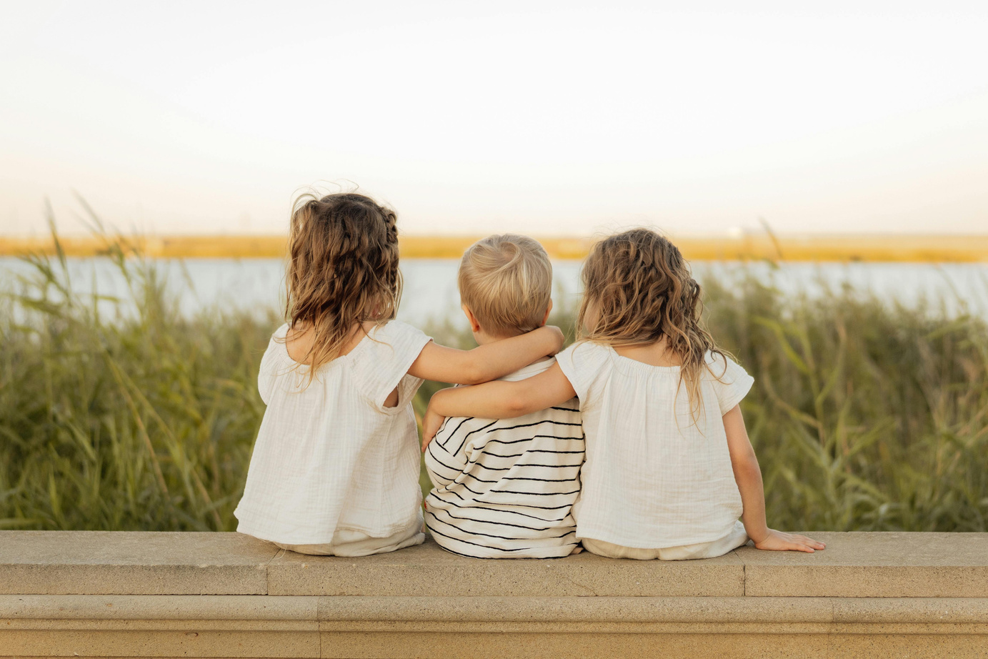
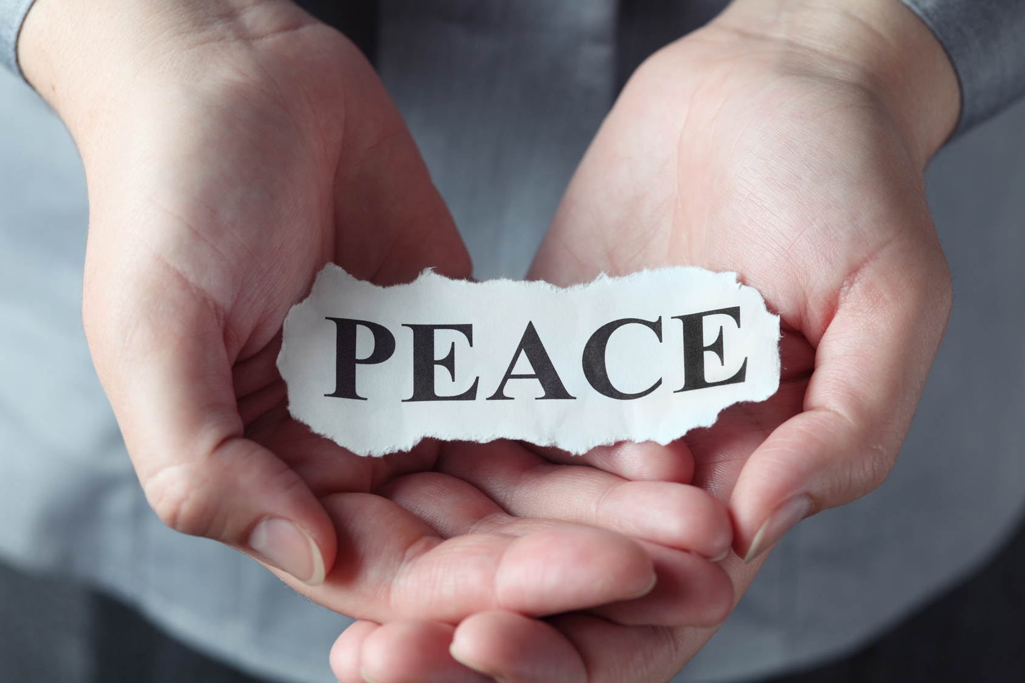
BLESSINGS !
"May your day be filled with peace, love, and light."

